Slide 1
Introduction To OpenGL

Slide 2
OpenGL Basic(core) library
A basic library of functions which is provided in OpenGL for specifying graphics primitives, attributes, geometric transformations, viewing transformations, and many other operations.

Slide 3
Basic OpenGL Syntax
Function names in the OpenGL basic library (also called the OpenGL core library) are prefixed with gl. The component word first letter is capitalized.
For eg:- glBegin, glClear, glCopyPixels, glPolygonMode
Symbolic constants that are used with certain functions as parameters are all in capital letters, preceded by “GL”, and component are separated by underscore.
For eg:- GL_2D, GL_RGB, GL_CCW, GL_POLYGON, GL_AMBIENT_AND_DIFFUSE.
The OpenGL functions also expect specific data types.
For example, an OpenGL function parameter might expect a value that is specified as a 32-bit integer. But the size of an integer specification can be different on different machines.
To indicate a specific data type, OpenGL uses special built-in, data-type names, such as GLbyte, GLshort, GLint, GLfloat, GLdouble, Glboolean

Slide 4
Related Libraries
In addition to OpenGL basic(core) library(prefixed with gl), there are a number of associated libraries for handling special operations:-
OpenGL Utility(GLU):- Prefixed with “glu”. It provides routines for setting up viewing and projection matrices, describing complex objects with line and polygon approximations, displaying quadrics and B-splines using linear approximations, processing the surface-rendering operations, and other complex tasks. -Every OpenGL implementation includes the GLU library
Open Inventor:- provides routines and predefined object shapes for interactive three dimensional applications which are written in C++.
Window-system libraries:- To create graphics we need display window. We cannot create the display window directly with the basic OpenGL functions since it contains only device-independent graphics functions, and window-management operations are device-dependent. However, there are several window-system libraries that supports OpenGL functions for a variety of machines. Eg:- Apple GL(AGL), Windows-to-OpenGL(WGL), Presentation Manager to OpenGL(PGL), GLX.
OpenGL Utility Toolkit(GLUT):- provides a library of functions which acts as interface for interacting with any device specific screen-windowing system, thus making our program device-independent. The GLUT library functions are prefixed with “glut”.

Slide 5
Header Files
In all graphics programs, we will need to include the header file for the OpenGL core library.
In windows to include OpenGL core libraries and GLU we can use the following header files:- #include //precedes other header files for including Microsoft windows version of OpenGL libraries
#include<GL/gl.h>
#include<GL/glu.h>
The above lines can be replaced by using GLUT header file which ensures gl.h and glu.h are included correctly,
#include <GL/glut.h> //GL in windows
In Apple OS X systems, the header file inclusion statement will be, #include<GLUT/glut.h>

Slide 6
Display-Window Management Using GLUT
We can consider a simplified example, minimal number of operations for displaying a picture.
Step 1: initialization of GLUT
We are using the OpenGL Utility Toolkit, our first step is to initialize GLUT.
This initialization function could also process any command line arguments, but we will not need to use these parameters for our first example programs.
We perform the GLUT initialization with the statement glutInit (&argc, argv);
Step 2: title
We can state that a display window is to be created on the screen with a given caption for the title bar. This is accomplished with the function glutCreateWindow ("An Example OpenGL Program");
where the single argument for this function can be any character string that we want to use for the display-window title.
Step 3: Specification of the display window
Then we need to specify what the display window is to contain.  For this, we create a picture using OpenGL functions and pass the picture definition to the GLUT routine glutDisplayFunc, which assigns our picture to the display window

Slide 7
Example: suppose we have the OpenGL code for describing a line segment in a procedure called line Segment.
Then the following function call passes the line-segment description to the display window: glutDisplayFunc (lineSegment);
Step 4: one more GLUT function
But the display window is not yet on the screen.
We need one more GLUT function to complete the window-processing operations.
After execution of the following statement, all display windows that we have created, including their graphic content, are now activated: glutMainLoop ( );
This function must be the last one in our program. It displays the initial graphics and puts the program into an infinite loop that checks for input from devices such as a mouse or keyboard.
Step 5: these parameters using additional GLUT functions
Although the display window that we created will be in some default location and size, we can set these parameters using additional GLUT functions.

Slide 8
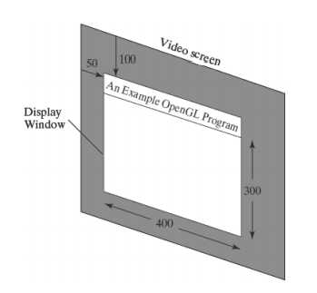
GLUT Function 1:
We use the glutInitWindowPosition function to give an initial location for the upper left corner of the display window.
This position is specified in integer screen coordinates, whose origin is at the upper-left corner of the screen.

Slide 9
GLUT Function 2:
After the display window is on the screen, we can reposition and resize it.
GLUT Function 3:
We can also set a number of other options for the display window, such as buffering and a choice of color modes, with the glutInitDisplayMode function.
Arguments for this routine are assigned with symbolic GLUT constants.
Example: the following command specifies that a single refresh buffer is to be used for the display window and that we want to use the color mode which uses red, green, and blue (RGB) components to select color values: glutInitDisplayMode (GLUT_SINGLE | GLUT_RGB);
The values of the constants passed to this function are combined using a logical or operation.
Actually, single buffering and RGB color mode are the default options.
But we will use the function now as a reminder that these are the options that are set for our display.

Slide 10
A Complete OpenGL Program
Step 1: to set background color
For the display window, we can choose a background color.
Using RGB color values, we set the background color for the display window to be white, with the OpenGL function: glClearColor (1.0, 1.0, 1.0, 0.0);
The first three arguments in this function set the red, green, and blue component colors to the value 1.0, giving us a white background color for the display window.
If, instead of 1.0, we set each of the component colors to 0.0, we would get a black background

Slide 11
The fourth parameter in the glClearColor function is called the alpha value for the specified color.
One use for the alpha value is as a “blending” parameter
When we activate the OpenGL blending operations, alpha values can be used to determine the resulting color for two overlapping objects.
An alpha value of 0.0 indicates a totally transparent object, and an alpha value of 1.0 indicates an opaque object.
For now, we will simply set alpha to 0.0.
Although the glClearColor command assigns a color to the display window, it does not put the display window on the screen.

Slide 12
Step 2: to set window color
To get the assigned window color displayed, we need to invoke the following OpenGL function: glClear (GL_COLOR_BUFFER_BIT);
The argument GL COLOR BUFFER BIT is an OpenGL symbolic constant specifying that it is the bit values in the color buffer (refresh buffer) that are to be set to the values indicated in the glClearColor function. (OpenGL has several different kinds of buffers that can be manipulated.
Step 3: to set color to object
In addition to setting the background color for the display window, we can choose a variety of color schemes for the objects we want to display in a scene.
For our initial programming example, we will simply set the object color to be a dark green glColor3f (0.0, 0.4, 0.2);
The suffix 3f on the glColor function indicates that we are specifying the three RGB color components using floating-point (f) values.
This function requires that the values be in the range from 0.0 to 1.0, and we have set red = 0.0, green = 0.4, and blue = 0.2.

Slide 13
The first OpenGL program is organized into three functions.
init: We place all initializations and related one-time parameter settings in function init.
lineSegment: Our geometric description of the “picture” that we want to display is in function lineSegment, which is the function that will be referenced by the GLUT function glutDisplayFunc.
main function main function contains the GLUT functions for setting up the display window and getting our line segment onto the screen.
glFlush: This is simply a routine to force execution of our OpenGL functions, which are stored by computer systems in buffers in different locations, depending on how OpenGL is implemented.
The procedure lineSegment that we set up to describe our picture is referred to as a display callback function.
And this procedure is described as being “registered” by glutDisplayFunc as the routine to invoke whenever the display window might need to be redisplayed

Slide 14
#include<GLUT/glut.h> // (or others, depending on the system in use)
void init (void)
{
glClearColor (1.0, 1.0, 1.0, 0.0); // Set display-window color to white.
glMatrixMode (GL_PROJECTION); // Set projection parameters. gluOrtho2D (0.0, 200.0, 0.0, 150.0);
}
void lineSegment (void)
{
glClear (GL_COLOR_BUFFER_BIT); // Clear display window.
glColor3f (0.0, 0.4, 0.2); // Set line segment color to green.
glBegin (GL_LINES);
glVertex2i (180, 15); // Specify line-segment geometry.
glVertex2i (10, 145);
glEnd ( );
glFlush ( ); // Process all OpenGL routines as quickly as possible.
}

Slide 15
void main (int argc, char** argv)
{
glutInit (&argc, argv); // Initialize GLUT.
glutInitDisplayMode (GLUT_SINGLE | GLUT_RGB); // Set display mode. glutInitWindowPosition (50, 100); // Set top-left display-window position.
glutInitWindowSize (400, 300); // Set display-window width and height. glutCreateWindow ("An Example OpenGL Program"); // Create display window.
init ( ); // Execute initialization procedure.
glutDisplayFunc (lineSegment); // Send graphics to display window.
glutMainLoop ( ); // Display everything and wait.
}

Slide 16
Coordinate Reference Frames
To describe a picture, we first decide upon A convenient Cartesian coordinate system, called the world-coordinate reference frame, which could be either 2D or 3D.
We then describe the objects in our picture by giving their geometric specifications in terms of positions in world coordinates.
Example: We define a straight-line segment with two endpoint positions, and a polygon is specified with a set of positions for its vertices.
These coordinate positions are stored in the scene description along with other info about the objects, such as their color and their coordinate extents Co-ordinate extents :Co-ordinate extents are the minimum and maximum x, y, and z values for each object.
A set of coordinate extents is also described as a bounding box for an object. Ex: For a 2D figure, the coordinate extents are sometimes called its bounding rectangle.
Objects are then displayed by passing the scene description to the viewing routines which identify visible surfaces and map the objects to the frame buffer positions and then on the video monitor.
The scan-conversion algorithm stores info about the scene, such as color values, at the appropriate locations in the frame buffer, and then the scene is displayed on the output device.

Slide 17
Screen co-ordinates:
Locations on a video monitor are referenced in integer screen coordinates, which correspond to the integer pixel positions in the frame buffer.
Scan-line algorithms for the graphics primitives use the coordinate descriptions to determine the locations of pixels
Example: given the endpoint coordinates for a line segment, a display algorithm must calculate the positions for those pixels that lie along the line path between the endpoints.
Since a pixel position occupies a finite area of the screen, the finite size of a pixel must be taken into account by the implementation algorithms.
For the present, we assume that each integer screen position references the centre of a pixel area.
Once pixel positions have been identified the color values must be stored in the frame buffer

Slide 18
Absolute and Relative Coordinate Specifications
Absolute coordinate:
So far, the coordinate references that we have discussed are stated as absolute coordinate values.
This means that the values specified are the actual positions within the coordinate system in use.
Relative coordinates:
However, some graphics packages also allow positions to be specified using relative coordinates.
This method is useful for various graphics applications, such as producing drawings with pen plotters, artist’s drawing and painting systems, and graphics packages for publishing and printing applications.
Taking this approach, we can specify a coordinate position as an offset from the last position that was referenced (called the current position).

Slide 19
Specifying a Two-Dimensional World-Coordinate Reference Frame in OpenGL
The gluOrtho2D command is a function we can use to set up any 2D Cartesian reference frames.
The arguments for this function are the four values defining the x and y coordinate limits for the picture we want to display.
Since the gluOrtho2D function specifies an orthogonal projection, we need also to be sure that the coordinate values are placed in the OpenGL projection matrix.
In addition, we could assign the identity matrix as the projection matrix before defining the world-coordinate range.
This would ensure that the coordinate values were not accumulated with any values we may have previously set for the projection matrix.
Thus, for our initial two-dimensional examples, we can define the coordinate frame for the screen display window with the following statements
glMatrixMode (GL_PROJECTION);
glLoadIdentity ( );
gluOrtho2D (xmin, xmax, ymin, ymax);

Slide 20
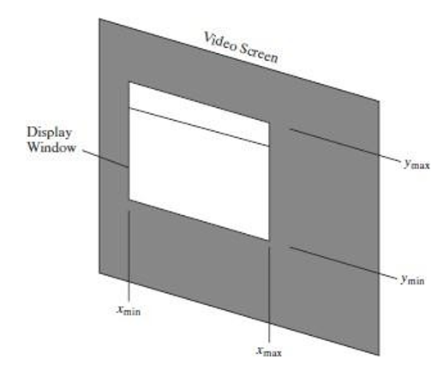
The display window will then be referenced by coordinates (xmin, ymin) at the lower-left corner and by coordinates (xmax, ymax) at the upper-right corner, as shown in Figure below

Slide 21
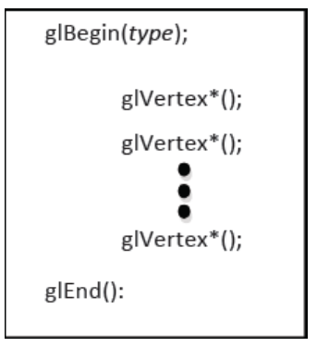
OpenGL Functions
Geometric Primitives:
It includes points, line segments, polygon etc. ➢ These primitives pass through geometric pipeline which decides whether the primitive is visible or not and also how the primitive should be visible on the screen etc.
The geometric transformations such rotation, scaling etc. can be applied on the primitives which are displayed on the screen. The programmer can create geometric primitives as shown below:
where: glBegin indicates the beginning of the object that has to be displayed glEnd indicates the end of primitive

Slide 22
OpenGL Point Functions
The type within glBegin() specifies the type of the object and its value can be as follows: GL_POINTS
Each vertex is displayed as a point.
The size of the point would be of at least one pixel.
Then this coordinate position, along with other geometric descriptions we may have in our scene, is passed to the viewing routines.
Unless we specify other attribute values, OpenGL primitives are displayed with a default size and color.
The default color for primitives is white, and the default point size is equal to the size of a single screen pixel

Slide 23
Case 1:
glBegin (GL_POINTS);
glVertex2i (50, 100);
glVertex2i (75, 150);
glVertex2i (100, 200);
glEnd( );
Case 2:
we could specify the coordinate values for the preceding points in arrays such as
int point1 [ ] = {50, 100}; int point2 [ ] = {75, 150}; int point3 [ ] = {100, 200};
and call the OpenGL functions for plotting the three points as
glBegin(GL_POINTS);
glVertex2iv (point1);
glVertex2iv (point2);
glVertex2iv (point3);
glEnd( );
Case 3:
specifying two point positions in a three dimensional world reference frame. In this case, we give the coordinates as explicit floating-point values:
glBegin (GL_POINTS);
glVertex3f (-78.05, 909.72, 14.60); glVertex3f (261.91, -5200.67, 188.33);
glEnd ( );

Slide 24
OpenGL LINE FUNCTIONS
Primitive type is GL_LINES
Successive pairs of vertices are considered as endpoints and they are connected to form an individual line segments.
Note that successive segments usually are disconnected because the vertices are processed on a pair-wise basis.
we obtain one line segment between the first and second coordinate positions and another line segment between the third and fourth positions.
if the number of specified endpoints is odd, so the last coordinate position is ignored.

Slide 25
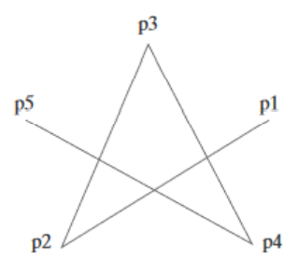
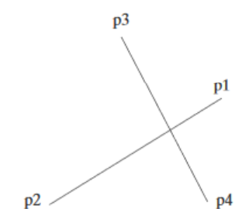
Case 1:
GL_LINES:
glBegin (GL_LINES);
glVertex2iv (p1);
glVertex2iv (p2);
glVertex2iv (p3);
glVertex2iv (p4);
glVertex2iv (p5);
glEnd ( );
Case 2:
Case 2:
GL_LINE_STRIP:
Successive vertices are connected using line segments. However, the final vertex is not connected to the initial vertex.
glBegin (GL_LINES_STRIP);
glVertex2iv (p1);
glVertex2iv (p2);
glVertex2iv (p3);
glVertex2iv (p4);
glVertex2iv (p5);
glEnd ( );

Slide 26
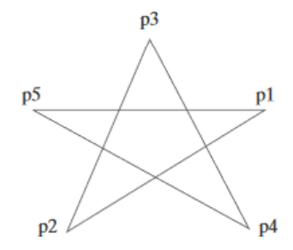
Case 3:
GL_LINE_LOOP:
Successive vertices are connected using line segments to form a closed path or loop i.e., final vertex is connected to the initial vertex.
glBegin (GL_LINES_LOOP);
glVertex2iv (p1);
glVertex2iv (p2);
glVertex2iv (p3);
glVertex2iv (p4);
glVertex2iv (p5);
glEnd ( );

Slide 27
Opengl Point-Attribute Functions
Color:
The displayed color of a designated point position is controlled by the current color values in the state list.
Also, a color is specified with either the glColor function or the glIndex function.
Size:
We set the size for an OpenGL point with glPointSize (size); and the point is then displayed as a square block of pixels.
Parameter size is assigned a positive floating-point value, which is rounded to an integer
The number of horizontal and vertical pixels in the display of the point is determined by parameter size.
Thus, a point size of 1.0 displays a single pixel, and a point size of 2.0 displays a 2×2 pixel array.
If we activate the antialiasing features of OpenGL, the size of a displayed block of pixels will be modified to smooth the edges.
The default value for point size is 1.0.

Slide 28
The following code segment plots three points in varying colors and sizes. The first is a standard-size red point, the second is a double-size green point, and the third is a triple-size blue point, Attribute functions may be listed inside or outside of a glBegin/glEnd pair.
glColor3f (1.0, 0.0, 0.0);
glBegin (GL_POINTS);
glVertex2i (50, 100);
glPointSize (2.0);
glColor3f (0.0, 1.0, 0.0);
glVertex2i (75, 150);
glPointSize (3.0);
glColor3f (0.0, 0.0, 1.0);
glVertex2i (100, 200);
glEnd ( );

Slide 29
Line-Attribute Functions OpenGL
OpenGL Line-Width Function
Line width is set in OpenGL with the function Syntax:
glLineWidth (width);
OpenGL Line-Style Function
We set a current display style for lines with the OpenGL function Syntax:
glLineStipple (repeatFactor, pattern);
Where Pattern:
Parameter pattern is used to reference a 16-bit integer that describes how the line should be displayed and 1 bit in the pattern denotes an “on” pixel position, and a 0 bit indicates an “off” pixel position.
repeatFactor
Integer parameter repeatFactor specifies how many times each bit in the pattern is to be repeated before the next bit in the pattern is applied. The default repeat value is 1.

Slide 30
Activating line style:
Before a line can be displayed in the current line-style pattern, we must activate the linestyle feature of OpenGL.
glEnable (GL_LINE_STIPPLE);
If we forget to include this enable function, solid lines are displayed; that is, the default pattern 0xFFFF is used to display line segments.
At any time, we can turn off the line-pattern feature with
glDisable (GL_LINE_STIPPLE);
This replaces the current line-style pattern with the default pattern (solid lines).

Slide 31
Example Code:
typedef struct { float x, y; } wcPt2D;
wcPt2D dataPts [5];
void linePlot (wcPt2D dataPts [5])
{
int k;
glBegin (GL_LINE_STRIP);
for (k = 0; k < 5; k++)
glVertex2f (dataPts [k].x, dataPts [k].y);
glFlush ( );
glEnd ( );
}

Slide 32
Curve Attributes
Parameters for curve attributes are the same as those for straight-line segments.
We can display curves with varying colors, widths, dot-dash patterns, and available pen or brush options.
Methods for adapting curve-drawing algorithms to accommodate attribute selections are similar to those for line drawing.
Raster curves of various widths can be displayed using the method of horizontal or vertical pixel spans.
Case 1: Where the magnitude of the curve slope |m| <= 1.0, we plot vertical spans;
Case 2: when the slope magnitude |m| > 1.0, we plot horizontal spans.

Slide 33
Different methods to draw a curve:
Method 1:
Using circle symmetry property, we generate the circle path with vertical spans in the octant from x = 0 to x = y, and then reflect pixel positions about the line y = x to y=0
Method 2:
Another method for displaying thick curves is to fill in the area between two Parallel curve paths, whose separation distance is equal to the desired width. We could do this using the specified curve path as one boundary and setting up the second boundary either inside or outside the original curve path. This approach, however, shifts the original curve path either inward or outward, depending on which direction we choose for the second boundary.

Slide 34
Method 3:
The pixel masks discussed for implementing line-style options could also be used in raster curve algorithms to generate dashed or dotted patterns
Method 4:
Pen (or brush) displays of curves are generated using the same techniques discussed for straight-line segments.
Method 5:
Painting and drawing programs allow pictures to be constructed interactively by using a pointing device, such as a stylus and a graphics tablet, to sketch various curve shapes.

Slide 35
Line Drawing Algorithm
A straight-line segment in a scene is defined by coordinate positions for the endpoints of the segment.
To display the line on a raster monitor, the graphics system must first project the endpoints to integer screen coordinates and determine the nearest pixel positions along the line path between the two endpoints then the line color is loaded into the frame buffer at the corresponding pixel coordinates
The Cartesian slope-intercept equation for a straight line is
y=m * x +b----------- >(1) with m as the slope of the line and b as the y intercept.
Given that the two endpoints of a line segment are specified at positions (x0,y0) and (xend, yend) ,as shown in fig.

Slide 36
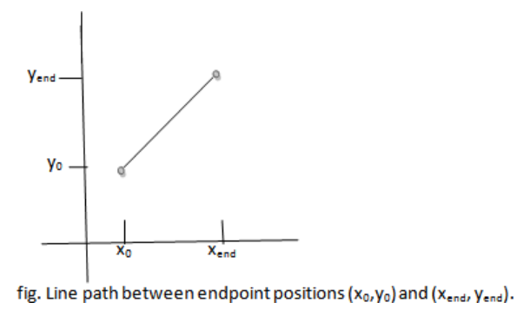
We determine values for the slope m and y intercept b with the following equations: m=(yend - y0)/(xend - x0)----------------->(2)
b=y0 - m.x0 ------------- >(3)
Algorithms for displaying straight line are based on the line equation (1) and calculations given in eq(2) and (3).
For given x interval δx along a line, we can compute the corresponding y interval δy from eq.(2) as δy=m. δx ---------------->(4)
Similarly, we can obtain the x interval δx corresponding to a specified δy as δx=δy/m ----------------- >(5)

Slide 37
For lines with slope magnitudes
|m|<1, δx can be set proportional to a small horizontal deflection voltage with the corresponding vertical deflection voltage set proportional to δy from eq.(4)
|m|>1, δy can be set proportional to a small vertical deflection voltage with the corresponding horizontal deflection voltage set proportional to δx from eq.(5)
|m|=1, δx=δy and the horizontal and vertical deflections voltages are equal

Slide 38
DDA Algorithm (DIGITAL DIFFERENTIAL ANALYZER)
The DDA is a scan-conversion line algorithm based on calculating either δy or δx.
A line is sampled at unit intervals in one coordinate and the corresponding integer values nearest the line path are determined for the other coordinate
DDA Algorithm has three cases so from equation i.e.,
m=(y_{k+1} - y_{k})/(x_{k+1} - x_{k})

Slide 39
Case1:
if m<1, x increment in unit intervals i.e..,x_{k+1}=x_{k}+1
then, m=(y_{k+1} - y_{k})/( x_{k+1} - x_{k})
m= y_{k+1} - y_{k}
y_{k+1} = y_{k} + m > (1)
where k takes integer values starting from 0, for the first point and increases by 1 until final endpoint is reached. Since m can be any real number between 0.0 and 1.0,

Slide 40
Case 2:
if m>1, y increment in unit intervals
i.e. , y_{k+1} = y_{k} + 1
then, m= (y_{k} + 1- y_{k})/( x_{k+1} - x_{k})
m(x_{k+1} - x_{k})=1
x_{k+1} =(1/m)+ x_{k} (2)

Slide 41
Case 3:
if m=1,both x and y increment in unit intervals
i.e. ,x_{k+1}=x_{k} + 1 and y_{k+1} = y_{k} + 1
Equations (1) and (2) are based on the assumption that lines are to be processed from the left endpoint to the right endpoint. If this processing is reversed, so that the starting endpoint is at the right, then either we have δx=-1 and
y_{k+1} = y_{k} - m (3)
or(when the slope is greater than 1)we have δy=-1 with x_{k+1} = x_{k} - (1/m) (4)

Slide 42
Summary of the DDA is
if m<1,where x is incrementing by 1
y_{k+1} = y_{k} + m
So initially x=0,Assuming (x0,y0)as initial point assigning x= x0,y=y0 which is the starting point .
Illuminate pixel(x, round(y))
x1= x+ 1 , y1=y + 1
Illuminate pixel(x1,round(y1))
x2= x1+ 1 , y2=y1 + 1
Illuminate pixel(x2,round(y2))
Till it reaches final point.
if m>1,where y is incrementing by 1
x_{k+1} =(1/m)+ x_{k}
So initially y=0,Assuming (x0,y0)as initial point assigning x= x0,y=y0 which is the starting point .
Illuminate pixel(round(x),y)
x1= x+( 1/m) ,y1=y
Illuminate pixel(round(x1),y1)
x2= x1+ (1/m) , y2=y1
Illuminate pixel(round(x2),y2)
Till it reaches final point.

Slide 43
So initially y=0,Assuming (x0,y0)as initial point assigning x= x0,y=y0 which is the starting point .
Illuminate pixel(round(x),y)
o x1= x+( 1/m) ,y1=y
Illuminate pixel(round(x1),y1)
o x2= x1+ (1/m) , y2=y1
Illuminate pixel(round(x2),y2)
Till it reaches final point.

Slide 44
#include <stdlib.h>
#include <math.h>
inline int round (const float a)
{
return int (a + 0.5);
}
void lineDDA (int x0, int y0, int xEnd, int yEnd)
{
int dx = xEnd - x0, dy = yEnd - y0, steps, k;
float xIncrement, yIncrement, x = x0, y =y0;
if (fabs (dx) > fabs (dy))
steps = fabs (dx);
else
steps = fabs (dy);
xIncrement = float (dx) / float (steps); yIncrement = float (dy) / float (steps); setPixel (round (x), round (y));
for (k = 0; k < steps; k++)
{
x += xIncrement;
y += yIncrement;
setPixel (round (x), round (y));
}
}

Slide 45
Bresenham’s Algorithm:
It is an efficient raster scan generating algorithm that uses incremental integral calculations
To illustrate Bresenham’s approach, we first consider the scan-conversion process for lines with positive slope less than 1.0.
Pixel positions along a line path are then determined by sampling at unit x intervals. Starting from the left endpoint (x0, y0) of a given line, we step to each successive column (x position) and plot the pixel whose scan-line y value is closest to the line path.
Consider the equation of a straight line y=mx+c where m=dy/dx

Slide 46
Bresenham’s Line-Drawing Algorithm
for |m| < 1.0
Input the two line endpoints and store the left endpoint in (x0, y0).
Set the color for frame-buffer position (x0, y0); i.e., plot the first point.
Calculate the constants ∆x, ∆y, 2∆y, and 2∆y − 2∆x, and obtain the starting value for the decision parameter as p0 = 2∆y −∆x
At each xk along the line, starting at k = 0, perform the following test: If pk < 0, the next point to plot is (xk + 1, yk ) and pk+1 = pk + 2∆y Otherwise, the next point to plot is (xk + 1, yk + 1) and pk+1 = pk + 2∆y − 2∆x
Repeat step 4 ∆x − 1 more times. Note: If |m|>1.0 Then p0 = 2∆x −∆y and
If pk < 0, the next point to plot is (xk , yk +1) and pk+1 = pk + 2∆x Otherwise, the next point to plot is (xk + 1, yk + 1) and pk+1 = pk + 2∆x − 2∆y

Slide 47
#include #include
/* Bresenham line-drawing procedure for |m| < 1.0. */
void lineBres (int x0, int y0, int xEnd, int yEnd)
{
int dx = fabs (xEnd - x0), dy = fabs(yEnd - y0);
int p = 2 * dy - dx;
int twoDy = 2 * dy, twoDyMinusDx = 2 * (dy - dx); int x, y;
/* Determine which endpoint to use as start position. */
if (x0 > xEnd)
{
x = xEnd; y = yEnd; xEnd = x0;
}
else
{
x = x0; y = y0;

Slide 48
setPixel (x, y);
while (x < xEnd)
{
x++;
if (p < 0)
p += twoDy;
else
{
y++;
p += twoDyMinusDx;
}
setPixel (x, y);
}
}

